Slide 1
Internet Protocols : Basics
Sankhayan Choudhury
Dept. of Computer Science
University of Calcutta

Slide 2
Outline
Internetworking problem
Internet’s Architectural principles
IP solution
IP forwarding
IP addressing
IP datagram Format
IP fragmentation & reassembly
Notes:
인터넷이 대두된 배경과, 설계 원칙들 그리고 IP에 특징에 대해서 설명하겠습니다.

Slide 3

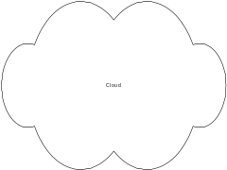
The Internetworking Problem
Two nodes communicating across a “network of networks”… How to transport packets through this heterogeneous mass ?
Problems: heterogeneity and scaling
A
B
Notes:
인터넷이 대두된 원인은 여러 서로 다른 네트워크를 연결하는데 있습니다.
여러 서로 다른 네트워크를 연결할 때 가장 큰 문제는 heterogeneity와 scaling문제입니다.

Slide 4
Internet’s Architectural principles
End-to-end principle: (Dave Clark, MIT)
  The network cannot be trusted
  Network provides minimum functionality (connectionless forwarding, routing)
  User must in any case check for errors
  Value-added functions at hosts (control functions): opposite of telephony model (phone simple, network complex)
Notes:
Internet이 어떻게 이 문제를 해결하는지에 앞서 설계상의 대 원칙을 설명하겠습니다.
먼저 e2e라고 하는 원칙이 있습니다. 이것은 network는 최소한의 기능만을 제공하는 것이 좋다는 원칙입니다.
Network는 error가 많이 일어날수 있어서 믿을 수 없기 때문에, error recovery 나 delivery acknowledgment등 여러 가지 기능들은 end node가 하는 것이 좋다는 것입니다. Delivery ack의 경우를 들면, 전송 주체인 application이 정말로 알고 싶은 ack는 target host가 자신이 보낸 정보에 의해 어떤 행동을
했는가인데 이것은 low-level에서 처리하기가 힘듭니다. 그래서 이러한 정보를 가장 많은 application이 이것을 맡아서 처리하자는 것입니다.

Slide 5
Architectural principles (contd)
  IP over everything:
    An internetworking protocol which works over all underlying sub-networks and provides a single, simple service model (“best-effort delivery”) to the user.
    Interconnection based on IP overlay over all kinds of networks
      Framing or encapsulation
      Address resolution
        IP-address to network address for each transport technology
      Unique IP-address
    Interconnection based on translation

Slide 6
Architectural principles (contd)
IP over everything:
  An internetworking protocol which works over all underlying sub-networks and provides a single, simple service model (“best-effort delivery”) to the user.
  Interconnection based on IP overlay over all kinds of networks
    Framing or encapsulation
    Address resolution
      IP-address to network address for each transport technology
    Unique IP-address
  Interconnection based on translation
Notes:
Vinston Cerf에 의해서 주장된 IP over everything이란 원칙은 이기종간의 network위해 IP network를 overlay network로 만들자라는 것입니다.
이 IP network를 통해서 upper layer와 lower layer를 interfacing해주자는 것인데 종종 IP hourglass로 표현되기도 합니다.

Slide 8
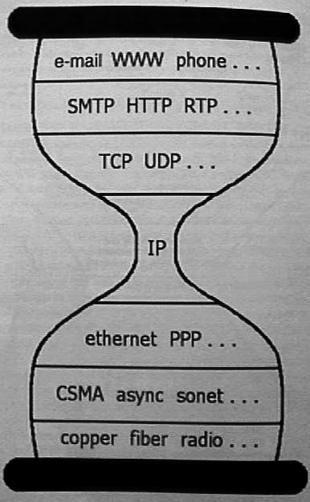
Hourglass design

Slide 9
IP solution
For heterogeneity, Provide new packet format and overlay it on subnets.
For scalability, Uses topological addressing
Implications: Hierarchical address, address resolution, fragmentation/re-assembly, packet format design, forwarding algorithm etc
Protocols: IP and ARP

Slide 10
Connecting Heterogeneous Networks(LAN-Internet)
Computer system used
  Special-purpose
  Dedicated
  Works with LAN or WAN technologies
  Known as
    Internet router
    Internet gateway
Notes:
서로 다른 network를 연결하는 데에는 특수한 시스템이 필요한데 바로 잘 아시는 gateway입니다.

Slide 11
An IP Internet – Network of Networks
Network 1 (Ethernet)
H7
R3
H8
H1
H2
H3
Network 4
(point-to-point)
Network 2 (Ethernet)
R1
R2
H4
Network 3 (FDDI)
H5
H6

Slide 12
Protocol Stack – IP is Common to All
H1
H8
TCP
R1
R2
R3
TCP
IP
IP
IP
IP
IP
ETH
ETH
FDDI
FDDI
PPP
PPP
ETH
ETH

Slide 13
IP Features
Connectionless service
  datagram/packet-based
Data forwarding
Addressing
Fragmentation and reassembly
Supports variable size datagrams
Best-effort delivery: Delay, out-of-order, corruption, and loss possible. Higher layers should handle these.

Slide 14
What IP does NOT provide
End-to-end data reliability & flow control (done by TCP or application layer protocols)
Sequencing of packets (like TCP)
Error detection in payload (TCP, UDP or other transport layers)
Error reporting (ICMP)
Setting up route tables (RIP, OSPF, BGP etc)
Connection setup (it is connectionless)
Address/Name resolution (ARP, RARP, DNS)

Slide 15
How does IP forwarding work ?
A) Source & Destination in same network Recognize that destination IP address is on same network.
  Find the destination LAN address.
  Send IP packet encapsulated in LAN frame directly to the destination LAN address.
    Encapsulation => source/destination IP addresses don’t change

Slide 16
IP forwarding (contd)
B) Source & Destination in different networks
Recognize that destination IP address is not on same network.
  Look up destination IP address in a (routing) table to find a match, called the next hop router IP address.
  Send packet encapsulated in a LAN frame to the LAN address corresponding to the IP address of the next-hop router.

Slide 17

Getting a datagram from source to dest.
routing table in A
Dest. Net. next router Nhops
223.1.1 1
223.1.2 223.1.1.4 2
IP datagram:
223.1.3 223.1.1.4 2
misc
fields
source
IP addr
dest
IP addr
data
A
223.1.1.1
datagram remains unchanged, as it travels source to destination
addr fields of interest here
223.1.2.1
223.1.1.2
223.1.1.4
223.1.2.9
B
223.1.2.2
E
223.1.1.3
223.1.3.27
223.1.3.1
223.1.3.2

Slide 18
Getting a datagram from source to dest.
misc
fields
Dest. Net. next router Nhops
223.1.1.1
223.1.1.3
data
223.1.1 1
Starting at A, given IP
datagram addressed to B:
look up net. address of B
find B is on same net. as A
link layer will send datagram directly to B inside link-layer frame
  B and A are directly connected
223.1.2 223.1.1.4 2
223.1.3 223.1.1.4 2
A
223.1.1.1
223.1.2.1
223.1.1.2
223.1.1.4
223.1.2.9
B
223.1.2.2
E
223.1.1.3
223.1.3.27
223.1.3.1
223.1.3.2

Slide 19
Getting a datagram from source to dest.
misc
fields
Dest. Net. next router Nhops
223.1.1.1
223.1.2.3
data
223.1.1 1
Starting at A, dest. E:
look up network address of E
E on different network
  A, E not directly attached
routing table: next hop router to E is 223.1.1.4
link layer sends datagram to router 223.1.1.4 inside link-layer frame
datagram arrives at 223.1.1.4
223.1.2 223.1.1.4 2
223.1.3 223.1.1.4 2
A
223.1.1.1
223.1.2.1
223.1.1.2
223.1.1.4
223.1.2.9
B
223.1.2.2
E
223.1.1.3
223.1.3.27
223.1.3.1
223.1.3.2

Slide 20
Getting a datagram from source to dest.
Dest. next
misc
fields
network router Nhops interface
223.1.1.1
223.1.2.3
data
223.1.1 - 1 223.1.1.4
Arriving at 223.1.4, destined for 223.1.2.2
look up network address of E
E on same network as router’s interface 223.1.2.9
  router, E directly attached
link layer sends datagram to 223.1.2.2 inside link-layer frame via interface 223.1.2.9
datagram arrives at 223.1.2.2!!! (hooray!)
223.1.2 - 1 223.1.2.9
223.1.3 - 1 223.1.3.27
A
223.1.1.1
223.1.2.1
223.1.1.2
223.1.1.4
223.1.2.9
B
223.1.2.2
E
223.1.1.3
223.1.3.27
223.1.3.1
223.1.3.2

Slide 21
Addressing & Resolution
[1] How to find if destination is in the same network ?
  IP address = network ID + host ID. Source and destination network IDs match => same network
  Splitting address into multiple parts is called hierarchical addressing
[2]: How to find the LAN address corresponding to an IP address ?
  Address Resolution Problem.
  Solution: ARP, RARP

Slide 22
Resolving Addresses
Hardware only recognizes MAC addresses
IP only uses IP addresses
Consequence: software needed to perform translation
  Part of network interface
  Known as address resolution

Slide 23
Address Resolution
Layer 2 protocol
Given
  A locally-connected network, N
  IP address C of computer on N
Find
  Hardware address for C
Technique
  Address Resolution Protocol

Slide 24
Address Resolution Protocol (ARP)
Key bindings in table
Table entry contains pair of addresses for one computer
  IP address
  Hardware address
Build table automatically as needed

Slide 25
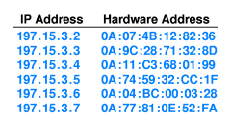
ARP Table
Only contains entries for computers on local network
IP network prefix in all entries identical

Slide 26
ARP Lookup Algorithm
Look for target IP address, T, in ARP table
If not found
  Send ARP request message to T
  Receive reply with T’s hardware address
  Add entry to table
Return hardware address from table

Slide 27
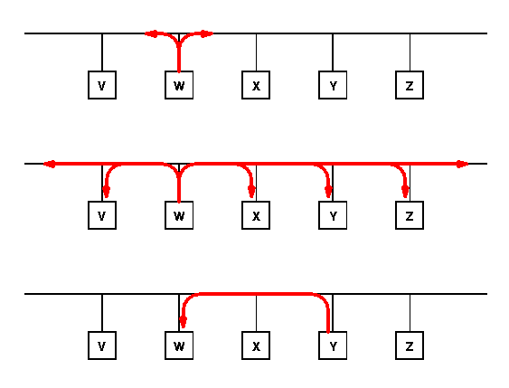
Illustration of ARP Exchange
W needs Y’s hardware address
Request sent via broadcast
Reply sent via unicast

Slide 28
IP Addresses
given notion of “network”, let’s re-examine IP addresses:
“class-full” addressing:
class
A
0
network
host
1.0.0.0 to
127.255.255.255
B
10
network
host
128.0.0.0 to
191.255.255.255
C
110
network
host
192.0.0.0 to
223.255.255.255
D
1110
multicast address
224.0.0.0 to
239.255.255.255
32 bits

Slide 29
Some special IP addresses
All-0s ⇒ This computer
All-1s ⇒ All hosts on this net (limited broadcast: don’t forward out of this net)
All-0 host suffix ⇒ Network Address (‘0’ means ‘this’)
All-1 host suffix ⇒ All hosts on the destination net (directed broadcast).
127.*.*.* ⇒ Loopback through IP layer

Slide 30
IP Addressing
Problem:
Address classes were too “rigid”. For most organizations, Class C were too small and Class B too big. Led to very inefficient use of address space, and a shortage of addresses.
Organizations with internal routers needed to have a separate (Class C) network ID for each link.
And then every other router in the Internet had to know about every network ID in every organization, which led to large address tables.
Small organizations wanted Class B in case they grew to more than 255 hosts. But there were only about 16,000 Class B network IDs.

Slide 31
IP Addressing
Two solutions were introduced:
Subnetting is used within an organization to subdivide the organization’s network ID.
Classless Interdomain Routing (CIDR) was introduced in 1993 to provide more efficient and flexible use of IP address space across the whole Internet.
CIDR is also known as “supernetting” because subnetting and CIDR are basically the same idea.

Slide 32
Subnetting
CLASS “B”
e.g. Company
2
14
16
10
Net ID
Host-ID
2
14
16
2
14
16
e.g. Site
0000
Host-ID
1111
Host-ID
10
Net ID
10
Net ID
Subnet ID (20)
Subnet
Host ID (12)
Subnet ID (20)
Subnet
Host ID (12)
2
14
16
2
14
16
e.g. Dept
Host-ID
10
Net ID
1111011011
Host-ID
10
Net ID
000000
Subnet ID (22)
Subnet
Host ID (10)
Subnet ID (26)
Subnet
Host ID (6)

Slide 33
Subnetting
Subnetting is a form of hierarchical routing.
Subnets are usually represented via an address plus a subnet mask or “netmask”.
e.g.
stanley@kaist.ac.kr > ifconfig hme0
hme0: flags=863<UP,BROADCAST,NOTRAILERS,RUNNING,MULTICAST> mtu 1500
inet 171.64.15.82 netmask ffffff00 broadcast 171.64.15.255
Netmask ffffff00: the first 24 bits are the subnet ID, and the last 8 bits are the host ID.
Can also be represented by a “prefix + length”, e.g. 171.64.15/24.

Slide 34
Classless Interdomain Routing
The IP address space is broken into line segments.
Each line segment is described by a prefix.
A prefix is of the form x/y where x indicates the prefix of all addresses in the line segment, and y indicates the length of the segment.
e.g. The prefix 128.9/16 represents the line segment containing addresses in the range: 128.9.0.0 … 128.9.255.255.
128.9.0.0
142.12/19
65/8
128.9/16
0
2³²-1
2¹⁶
128.9.16.14

Slide 35
Classless Interdomain Routing Addressing
128.9.19/24
128.9.25/24
128.9.16/20
128.9.176/20
128.9/16
0
2³²-1
128.9.16.14
Most specific route = “longest matching prefix”

Slide 36
IP datagram format
IP protocol version
number
32 bits
total datagram
length (bytes)
header length
(bytes)
head.
len
type of
service
ver
length
for
fragmentation/
reassembly
“type” of data
flgs
fragment
offset
16-bit identifier
max number
remaining hops
(decremented at
each router)
time to
live
upper
layer
Internet
checksum
32 bit source IP address
upper layer protocol
to deliver payload to
32 bit destination IP address
Options (if any)
E.g. timestamp,
record route
taken, pecify
list of routers
to visit.
data
(variable length,
typically a TCP
or UDP segment)

Slide 37
IP Datagram Format
First Word purpose: info, variable size header & packet.
  Version (4 bits)
  Internet header length (4 bits): units of 32-bit words. Min header is 5 words or 20 bytes.
  Type of service (TOS: 8 bits): Reliability, precedence, delay, and throughput. Not widely supported
  Total length (16 bits): header + data. Units of bytes. Total must be less than 64 kB.

Slide 38
IP Header (Cont)
2nd Word Purpose: fragmentation
  Identifier (16 bits): Helps uniquely identify the datagram between any source, destination address
  Flags (3 bits): More Flag (MF):more fragments Don’t Fragment (DF)
  Reserved
  Fragment offset (13 bits): In units of 8 bytes

Slide 39
IP Header (Cont)
Third word purpose: demuxing, error/looping control, timeout.
  Time to live (8 bits): Specified in router hops
  Protocol (8 bits): Next level protocol to receive the data: for de-multiplexing.
  Header checksum (16 bits): 1’s complement sum of all 16-bit words in the header.
    Change header => modify checksum using 1’s complement arithmetic.
Source Address (32 bits): Original source.
Does not change along the path.

Slide 40
Header Format (contd)
Destination Address (32 bits): Final destination. Does not change along the path.
Options (variable length): Security, source route, record route, stream id (used for voice) for reserved resources, timestamp recording
Padding (variable length):
Makes header length a multiple of 4
Payload Data (variable length): Data + header < 65,535 bytes

Slide 41
Maximum Transmission Unit
Each subnet has a maximum frame size
Ethernet: 1518 bytes
FDDI: 4500 bytes
Token Ring: 2 to 4 kB
Transmission Unit = IP datagram (data + header)
Each subnet has a maximum IP datagram length (header + payload) = MTU
Net 1
MTU=1500
Net 2
MTU=1000
S
R
R

Slide 42
Fragmentation
Datagrams larger than MTU are fragmented
Original header is copied to each fragment and then modified (fragment flag, fragment offset, length,...)
Some option fields are copied (see RFC 791)
IP Header
Original Datagram
IP Hdr 1
Data 1
IP Hdr 2
Data 2
IP Hdr 3
Data 3

Slide 43
Fragmentation Example
MTU = 1500B
MTU = 280B
IHL=5, ID = 111, More = 1
Offset = 0W, Len = 276B
IHL = 5, ID = 111, More = 0
Offset = 0W, Len = 472B
IHL=5, ID = 111, More = 0
Offset = 32W, Len = 216B
Payload size 452 bytes needs to be transmitted
across a Ethernet (MTU=1500B) and a SLIP line (MTU=280B)
Length = 472B, Header = 20B => Payload = 452B
Fragments need to be multiple of 8-bytes.
  Nearest multiple to 260 (280 -20B) is 256B
  First fragment length = 256B + 20B = 276B.
  Second fragment length = (452B- 256B) + 20B = 216B

Slide 44
Reassembly
Where to do reassembly?
  End nodes
Dangerous to do at intermediate nodes
  How much buffer space required at routers?
  What if routes in network change?
    Multiple paths through network
    All fragments only required to go through destination

